Slide 1
BIOMETRIC IDENTIFICATION USING DENTAL RADIOGRAPHS
Batch Memebers
1.Gautham S Kirthik 712816104010
2.S.Karthik 712816104015
3.Sneha S 712816104036 Guided By,
Prof.R.Thenmalar M.E
Department of CSE

Slide 2
Objective
The primary objective of the project is
To predict teeth structure in Opg Image .
Here we applying Deep Learning and Image processing for classification of features and comparison of images.

Slide 3
Problem Definition
In this project, a model of teeth structure recognition has been proposed to identify a person. The person’s teeth image have been matched with the datasets of teeth images. To identify person while in unpredictable deaths and natural disaster situations.

Slide 4
Abstract
In this paper used to improve detection precisions, we propose three post-processing techniques to supplement the baseline faster CNN according to certain prior domain knowledge. Filtering algorithm is constructed to delete overlapping boxes detected by faster CNN associated with the same tooth.In this paper already defined for labels in teeth image. The module based on a teeth is proposed to matching for training image and Testing images of detected teeth boxes to modify detected results that violate certain intuitive rules.In this proposed system for Deep learning method in convolution Neural Network (CNN) the Tensor Flow tool package to detect and number teeth in dental periapical films.

Slide 5
Existing System
The system using matlab for image processing through segmentation scheme’s
It uses machine learning algorithms such as
Support Vector Machine and Bayes
etc.,
Drawback:
Difficult to get accurate results
Poor discriminatory power
less classification accuracy

Slide 6
Proposed System
The system using some techniques for image acquisition.
It uses Deep learning methods such as
Convolution Neural Network for features
extraction and comparison.
Merits:
It achieve high-accuracy in segmentation.
It also uses Max pooling technique for high accuracy.

Slide 7
Block Diagram
Database
Images
Pre- processing
Feature Selection
Feature Extraction
CNN
Classifier
MRI Image
Pre- processing
Feature
Selection
(DWT)
Feature
Extraction
(GLCM)
Prediction

Slide 8
Modules
Training
Classification
Testing

Slide 9
Convolutional Neural Networks
To address this problem, bionic convolutional neural networks are proposed to reduced the number of parameters and adapt the network architecture specifically to vision tasks. Convolutional neural networks are usually composed by a set of layers that can be grouped by their functionalities.
Convolution Layer
The process is a 2D convolution on the inputs.
The “dot products” between weights and inputs are “integrated” across “channels”.
Filter weights are shared across receptive fields. The filter has same number of layers as input volume channels, and output volume has same “depth” as the number of filters.

Slide 10
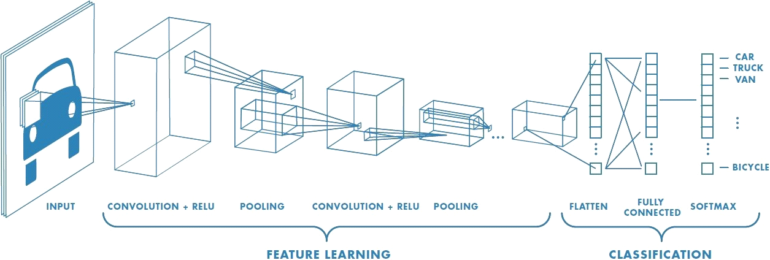
CNN Architecture

Slide 11
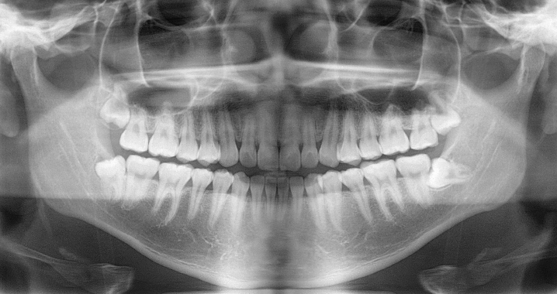
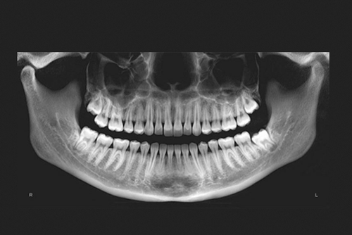
Teeth Opg Image

Slide 12
Application
Forensic identification
Medical Application
Biometrics Application

Slide 13
Software Requirement
Python 3.6 version
OpenCV
Tensorflow

Slide 14
References
Yu-cheng Chen, Derek Jin-Ki Hong, Chia-Wei Wu, Muralidhar Mupparapu. The Use of Deep Convolutional Neural Network in Biomedical Imaging. Journal of Orofacial Sciences.(2019) .
Karunya, Askarunisa, Athiraja. Human Identification Using Dental Biometrics.International Journal of Applied Engineering Research.(2014).
Georges Dibeh, Alaa Hilal, Jamal Charara. A Noval Approach for Dental Panoramic Radiograph Segmentation. International Multidisciplinary Conference on Engineering Technology.(2018).
Nomir O, Abdel-Mottaleb M. Human Identification From Dental X-Ray Images Based on the Shape and Appearance of the Teeth. IEEE Transactions on Information Forensics and Security. 2007;2:188– 197. doi: 10.1109/TIFS.2007.897245. [CrossRef] [Google Scholar]
Zhou J, Abdel-Mottaleb M. A content-based system for human identification based on bitewing dental X-ray images. Pattern Recognition. 2005;38:2132–2142. doi: 10.1016/j.patcog.2005.01.011. [CrossRef] [Google Scholar]

Slide 15


